Slide 2

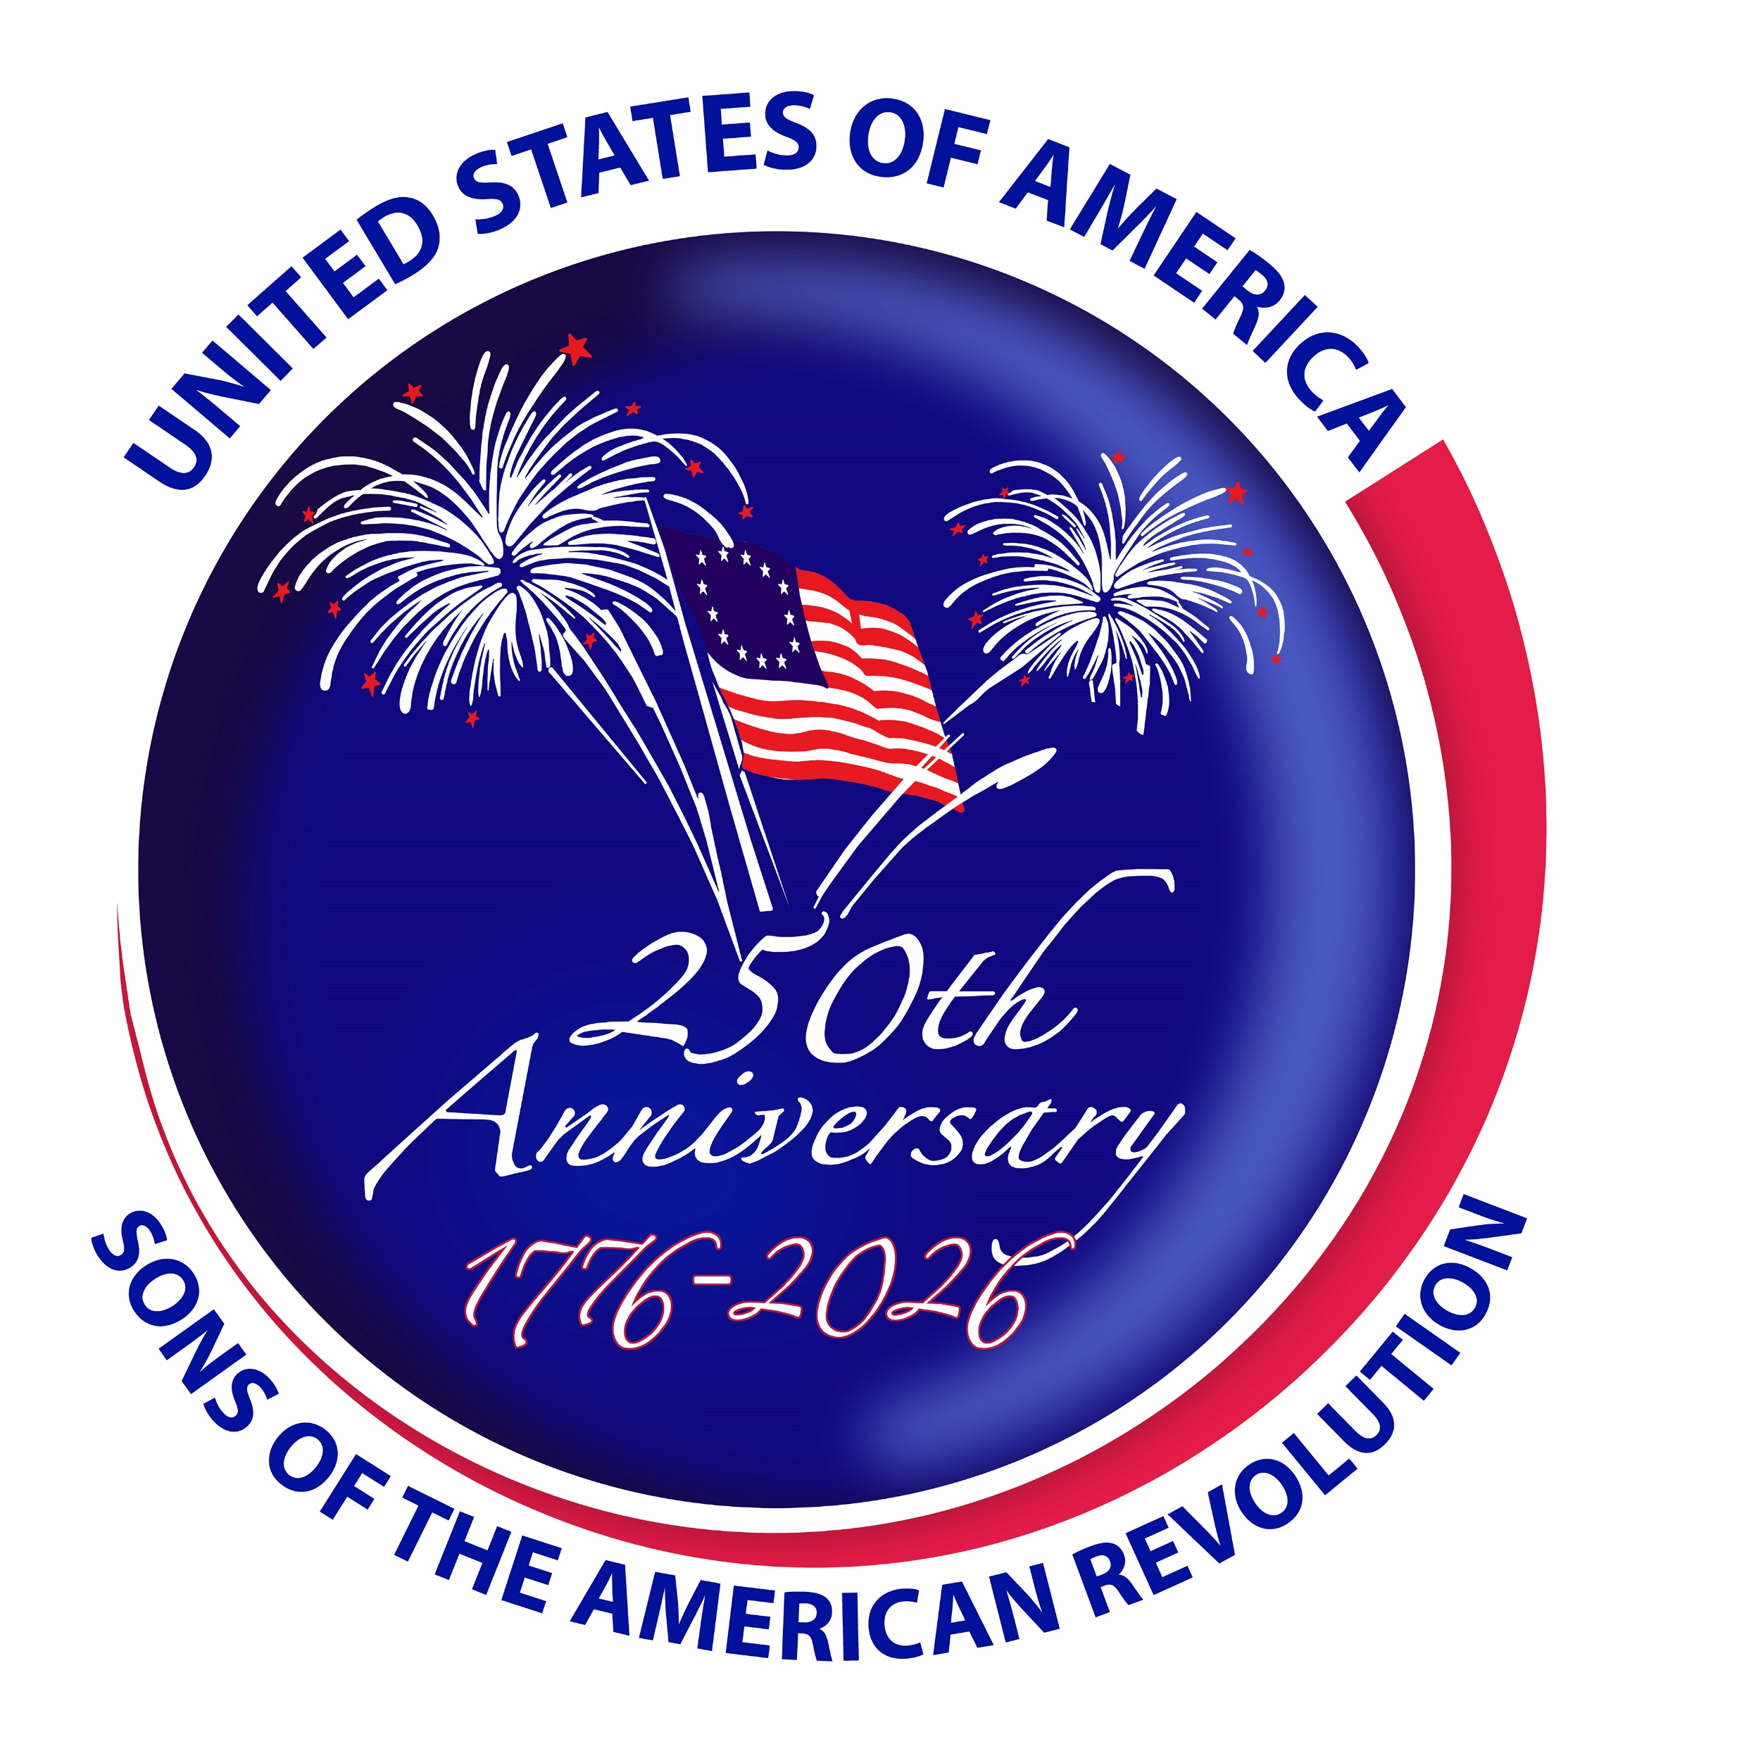
America 250 SAR Programs Committee

Slide 3

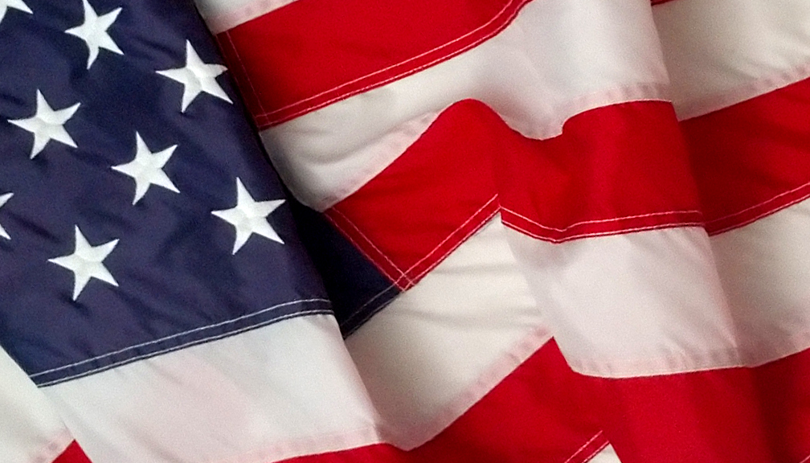
“To celebrate America’s 250th anniversary with Patriotic, Historical and Educational programs which raises the awareness of Americans about our past and help strengthen our democracy.”
SAR MISSION
Notes:
“The Mission of the Sons of the American Revolution is to celebrate America’s 250th anniversary with Patriotic, Historical and Educational programs which raise the awareness of Americans about our past and help strengthen our democracy.”

Slide 4
The America 250 SAR Committee
works on the national, state, and local levels to
promote the commemoration of the 250th Anniversary
of the American Revolution and the establishment
of the United States through Patriotic,
Historical and Educational programs.
Notes:
The SAR works on the national, state, and local levels
* To promote recognition of the 250th Anniversary
* To commemorate important events and persons of the Revolution
* To celebrate the 250th Anniversary of the Signing of the Declaration of Independence
* and To celebrate the American Revolution and the establishment of the United States through
Patriotic, Historical and Educational programs.

Slide 5
#1
Raise awareness of the SAR as a Patriotic Organization and Reenergize America’s Sense of Patriotism. Examples to date include:
  Color Guard Participation - 4th of July, Veterans Day, Flag Day, Patriots Day, Yorktown Day
  Wreaths Across America
  Flag Retirement
  Honor Flight
  Patriot Sons and Daughters
  Veterans Support
SAR GOALS
PATRIOTIC PROGRAMS
Notes:
Our first goal is to raise the awareness of the Sons of the American Revolution as a Patriotic Organization and Reenergize America’s Sense of Patriotism.
Our patriotic programs can be as simple as a wreath laying at the tomb of a revolutionary veteran or as
elaborate as creating a community-wide Flag Day Celebration, involving elected officials, citizen leaders, DAR members, Scouts, and other members of the community.
.

Slide 6
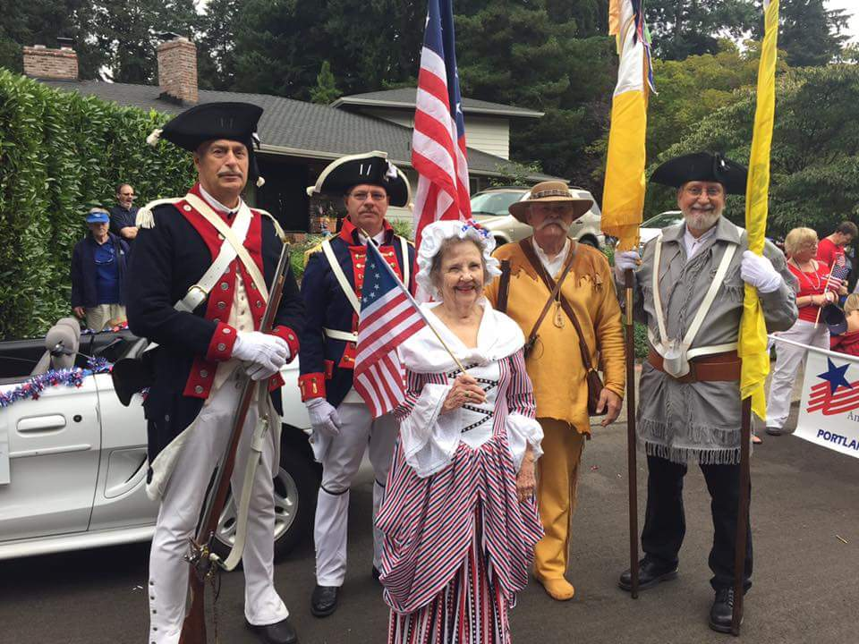
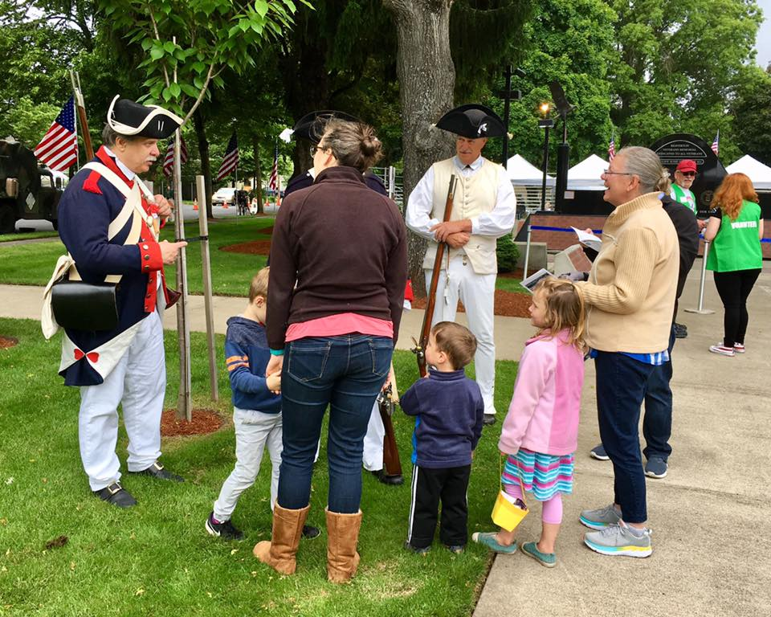
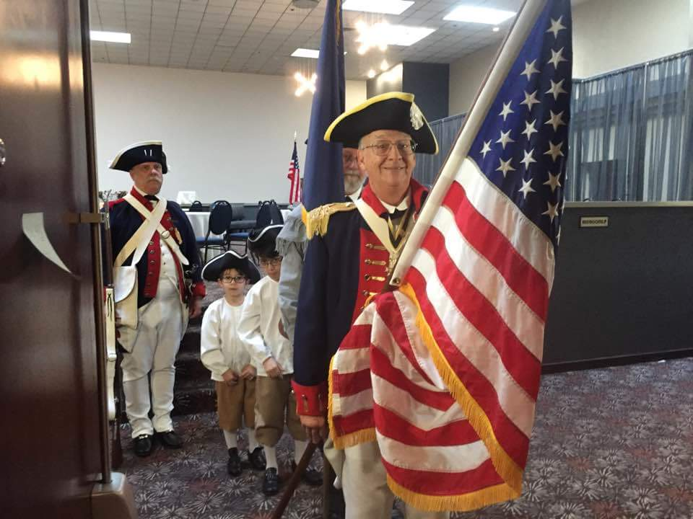
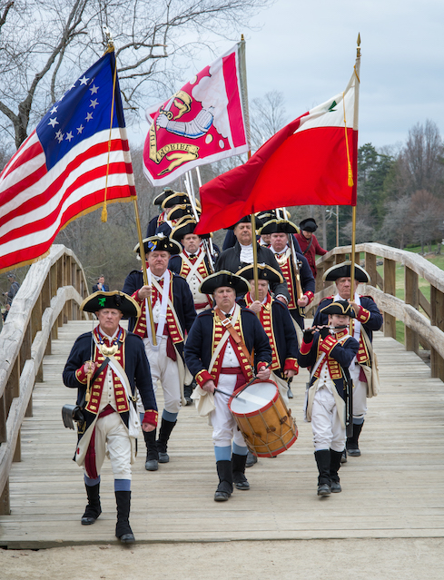
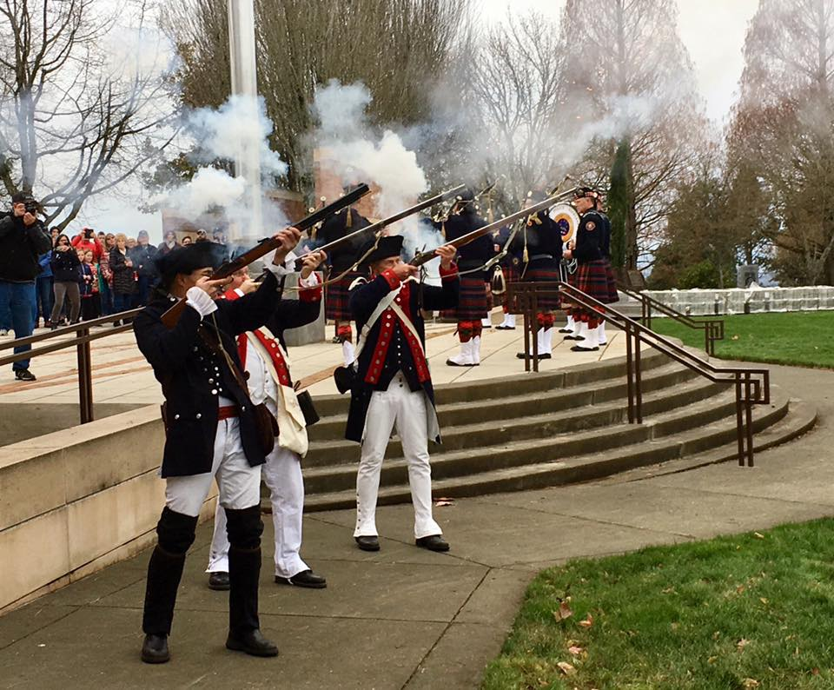
4th Of July
Veterans Day
Flag Day
Yorktown Day
COLOR GUARD
Patriots Day
PATRIOTIC PROGRAMS
Notes:
You often see SAR Color Guard Participation in community events such as:
4th of July parades and celebrations
Veterans Day ceremonies and recognition of veterans
Flag Day community celebrations and flag history presentations
Patriots Day celebrations can be simple or complex including small gatherings of students or community wide celebrations.
Yorktown Day is a great opportunity to discuss the surrender of Cornwallis and the next chapter in forming a new nation.

Slide 7
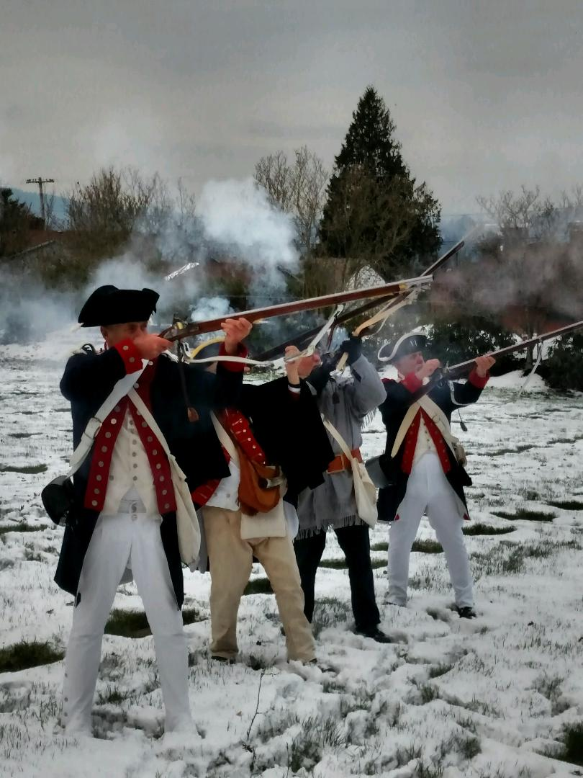
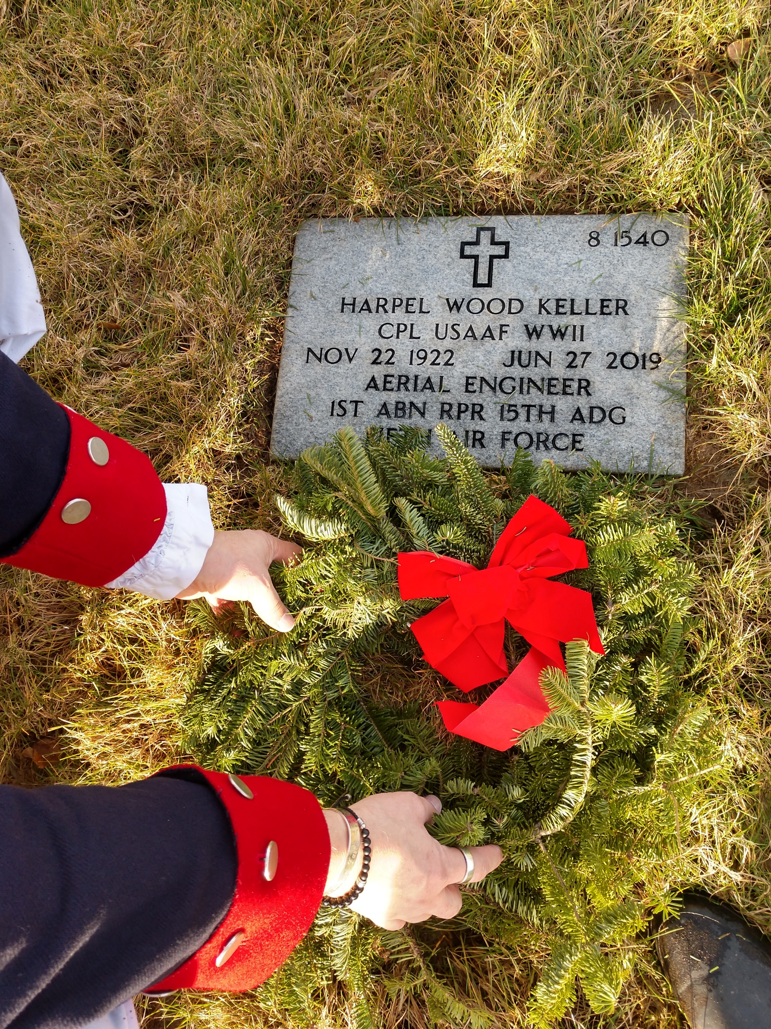
WREATHS ACROSS AMERICA
PATRIOTIC PROGRAMS
Notes:
SAR Compatriots mark Wreaths Across America each December on National Wreaths Across America Day. The mission to Remember, Honor and Teach is carried out by coordinating wreath-laying ceremonies at Arlington National Cemetery, as well as at more than 2,500 additional locations in all 50 U.S. states, at sea and abroad.
Many SAR chapters or their members sponsor a veterans’ wreath at a nearby cemetery, volunteering time to place wreaths or donating to a local sponsorship group.
Most SAR Chapters have a Wreaths Across America Ceremony to honor those who have served their country.

Slide 8
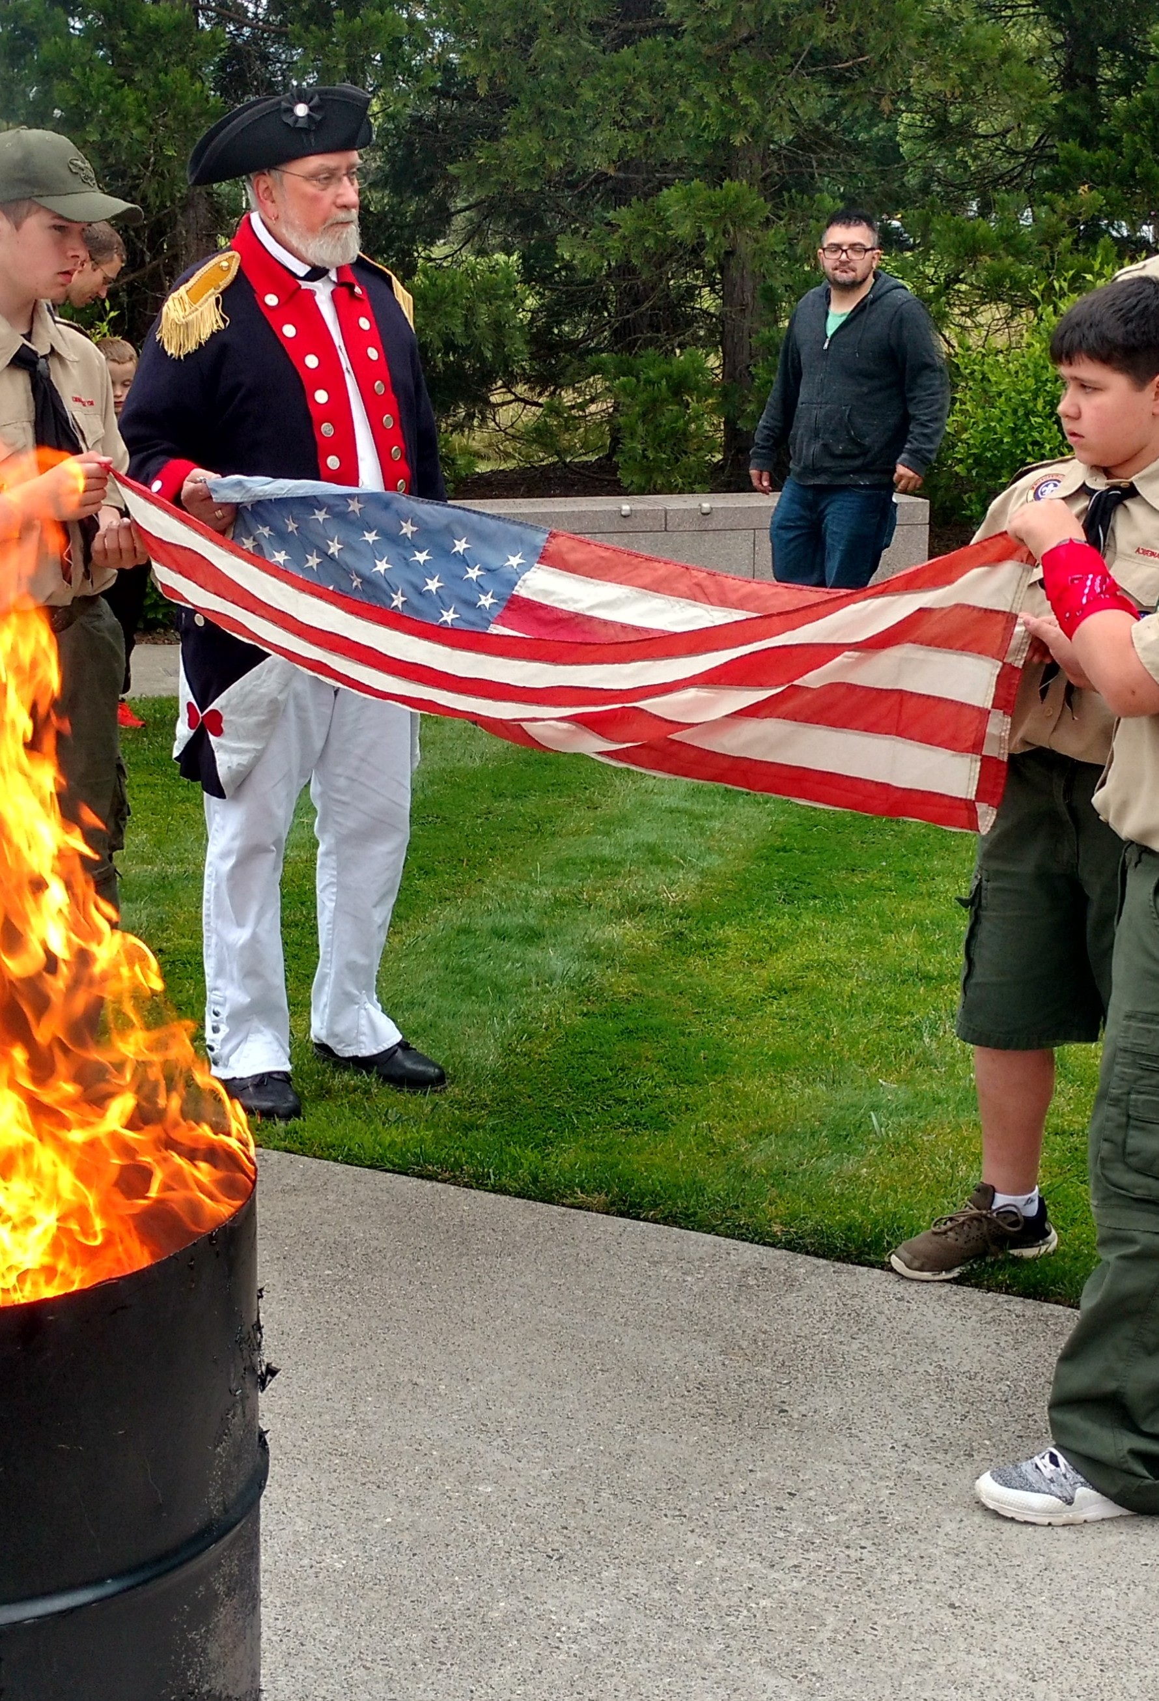
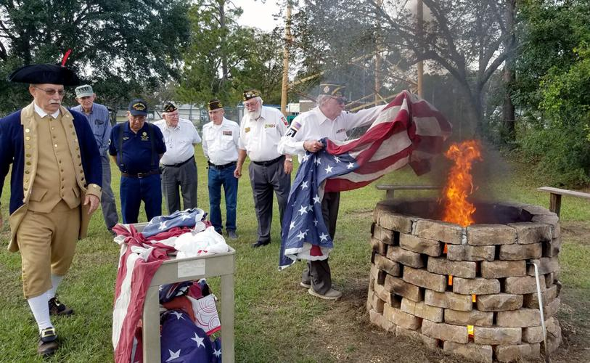
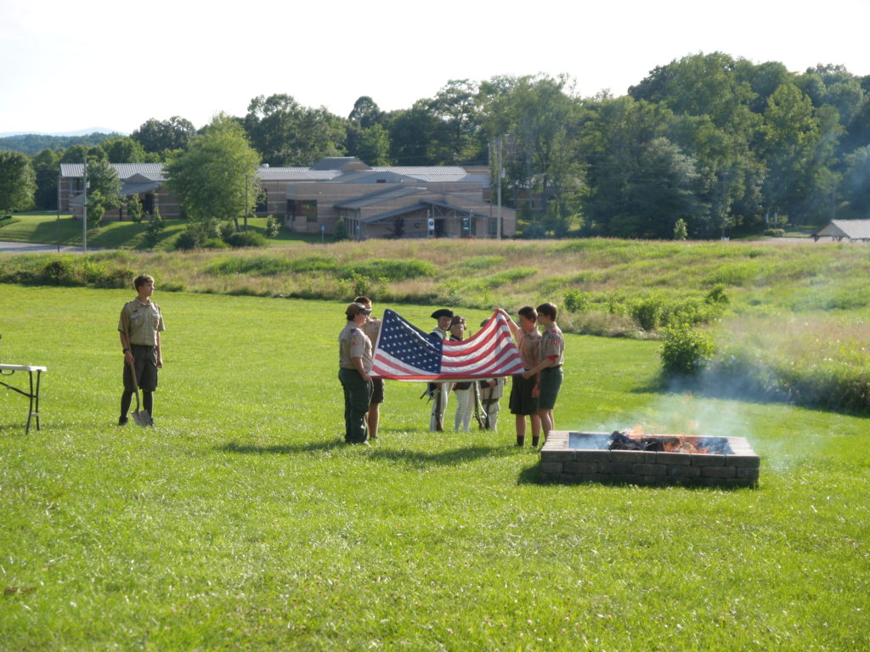
FLAG RETIREMENT
PATRIOTIC PROGRAMS
Notes:
When flags become worn, torn, or faded and they are no longer serviceable, it is recommended that they be permanently retired.
Unserviceable flags should not be reused or recycled but destroyed in a dignified manner in an appropriate Flag Retirement Ceremony.
The Sons of the American Revolution carry out many local flag retirement ceremonies throughout the year, most notably on Flag Day, June 14. These ceremonies often consist of uniformed color guards, colonial music, and collaboration with other community organizations to render final honors to a well-worn emblem of our nation's history.

Slide 9
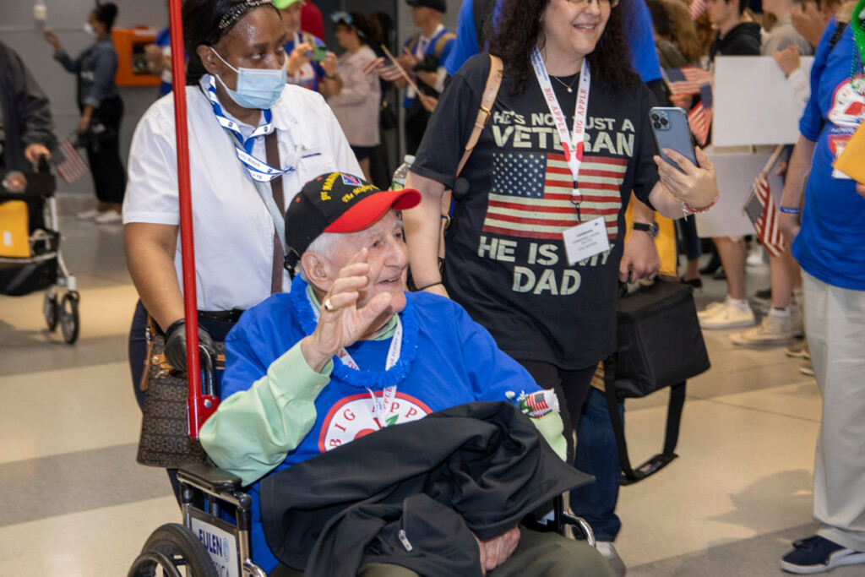
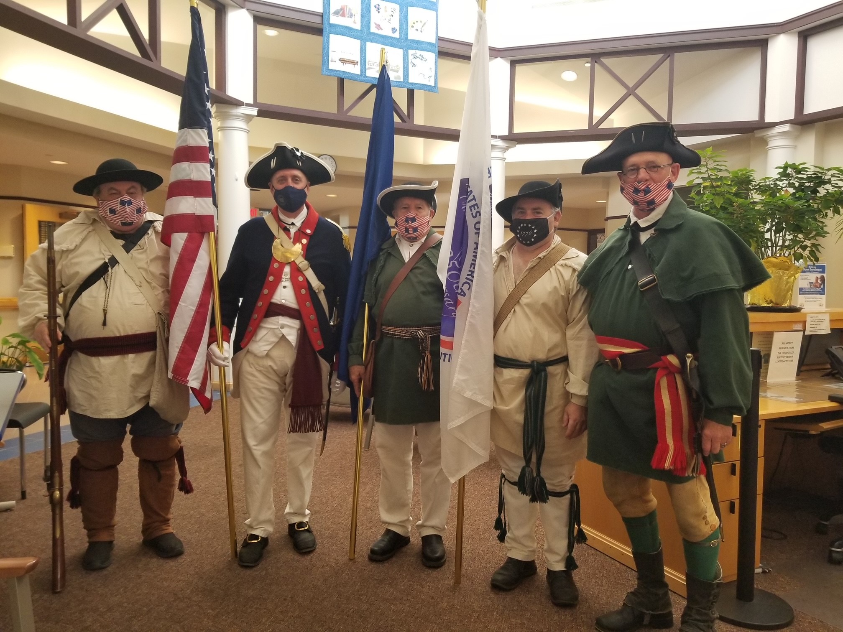
HONOR FLIGHT
PATRIOTIC PROGRAMS
Notes:
One way that the SAR honors our veterans is through support of the Honor Flights program which honors World War Two, Korean War and Vietnam era veterans for their service and sacrifice by providing them with a sponsored trip to Washington D.C. While they are there, they are given the full VIP treatment as they visit the various sites in and around the city. On the top of the itinerary, is a visit to each of the various veteran’s memorials for memorials for the Army, Navy, Air Force, Marines, and Coast Guard to pay their respects to their fallen comrades.

Slide 10
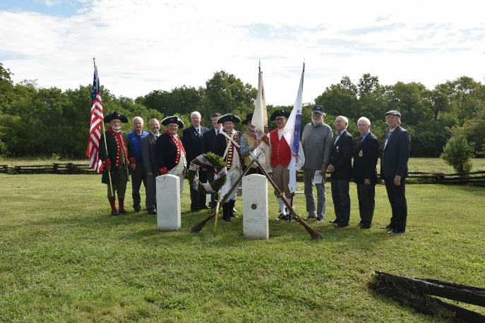
PATRIOT SONS & DAUGHTERS
PATRIOTIC PROGRAMS
Notes:
The Patriot Sons and Daughters program is an opportunity to celebrate the lives of our Patriot Ancestors while recognizing one of their children or
grandchildren who are buried in your area. Many times these individuals are the early settlers to your region and become community leaders, such as
teachers, preachers, political officials and leading businessmen and women. Honoring these Patriot Sons and Daughters is another way of bringing
home our connection to our founding fathers.

Slide 11
#2
Make the American Revolution and ‘Our’ Colonial History Relevant Again. Examples to date include:
    Flag Day
    Our Patriots
    Revolutionary War Timeline
    America 250 Minute
    Traveling Trunk
SAR GOALS
HISTORICAL PROGRAMS
Notes:
Our Second goal is to promote Historical Programs which may include the recognition of historic homes, burial sites, forts, or citizens of prominence who have some relation to the American Revolution or other historic periods. It is important for the SAR to offer historical programs to students and the community in general, as schools place less emphasis on Revolutionary History.

Slide 12
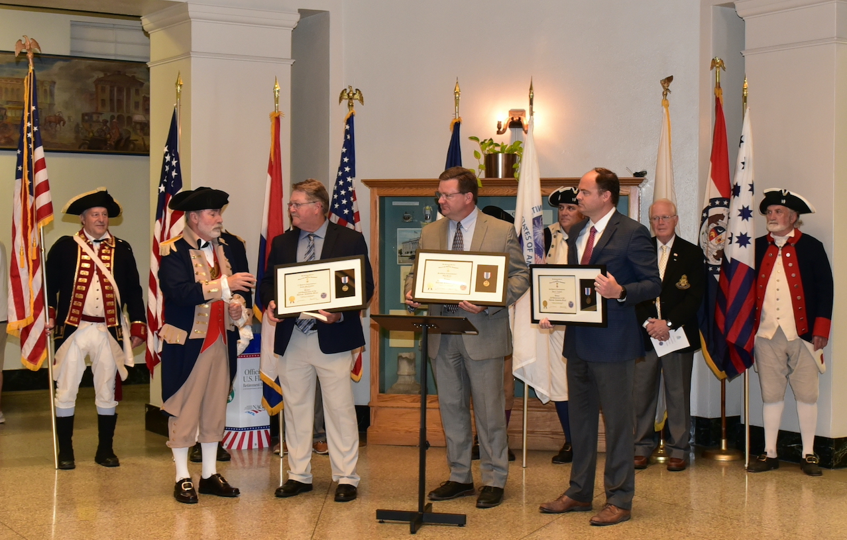
FLAG DAY
HISTORICAL PROGRAMS
Notes:
The SAR supports Flag Day across America. On June 14, 1777, the Continental Congress passed a resolution adopting a flag for our new Nation.
This resolution specified 13 alternating red and white stripes with 13 stars on a blue field. The stars represented the colonies that declared independence, and in the years since our founding, they have grown into 50 United States which comprise our great country today. For centuries, mariners looked to the stars to guide them across the seas, just as Americans and people across the globe look to our flag as a guiding symbol of freedom, opportunity, and hope. On Flag Day and during National Flag Week, the SAR honors the journey of progress represented in our banner and pays tribute to the inspiration it gives Americans at home and abroad.

Slide 13
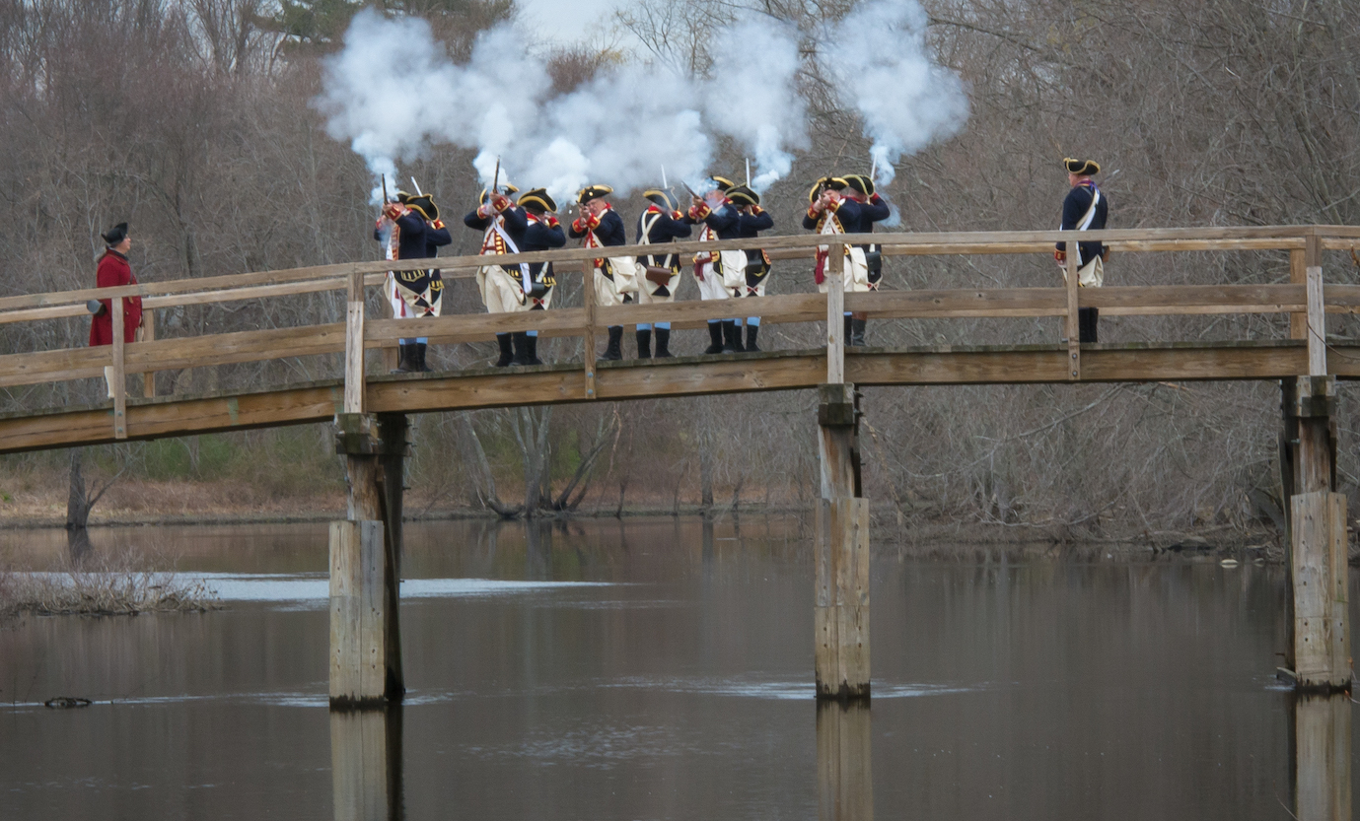
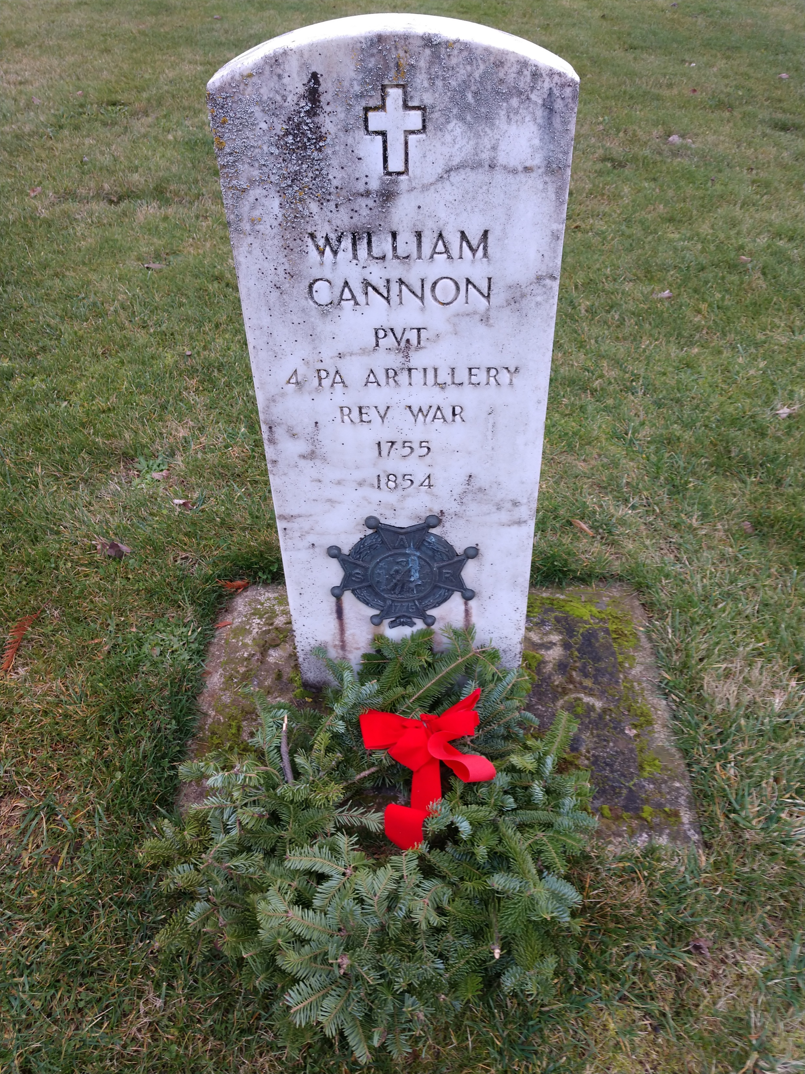
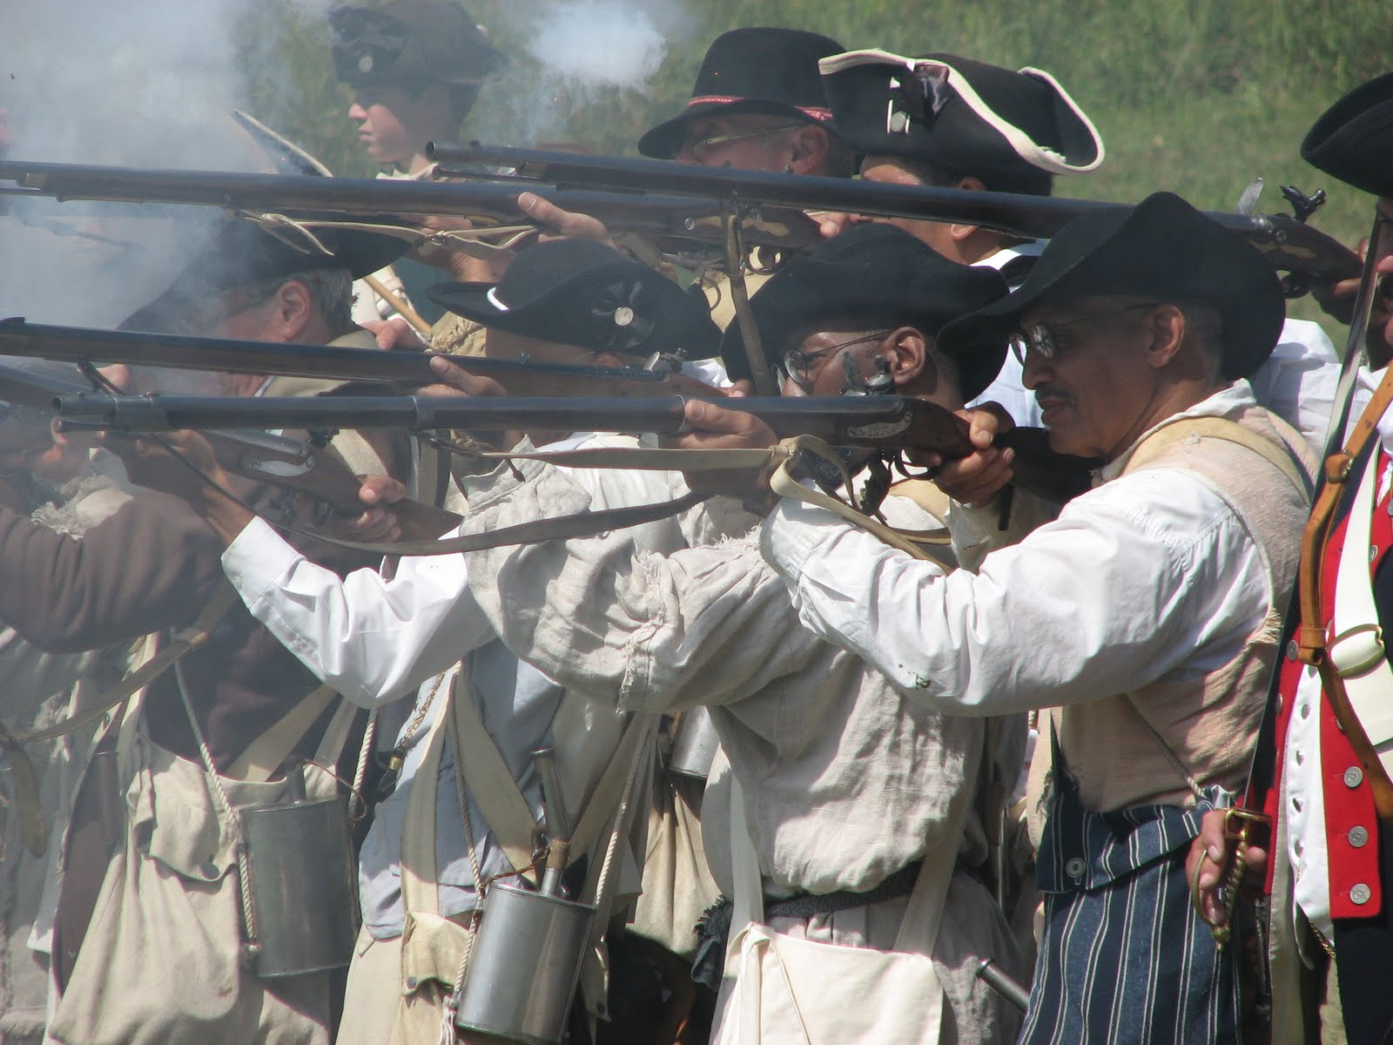
OUR PATRIOTS
HISTORICAL PROGRAMS
Notes:
The Sons of the American Revolution have chosen the Our Patriots Program as an ideal way to interact with other lineage societies, archives and community groups who have an interest in collecting information on the early founders of their area and their connection to their Patriot Ancestors.
Revolutionary War veterans and their descendants are buried across this country and the Our Patriot Program allows them to gather information on these heroes of the Revolution and build a database of importance to the region. Using these early genealogical records along with succeeding generations allow us to celebrate their lives and contributions to our great nation.

Slide 14
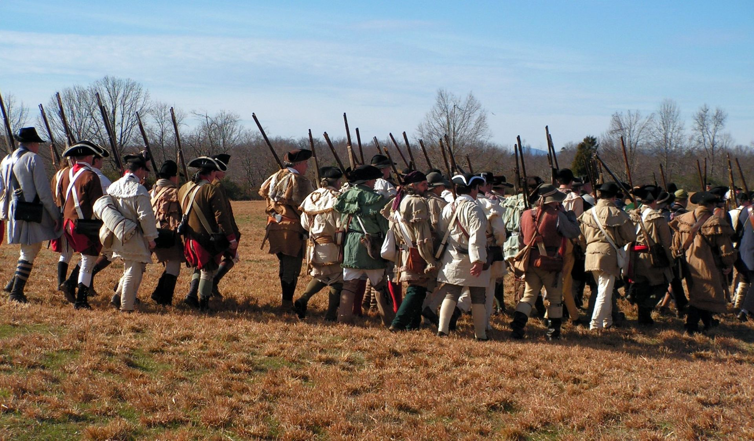
REVOLUTIONARY WAR TIMELINE
HISTORICAL PROGRAMS
Notes:
We at the SAR focus on a Revolutionary War Timeline as an important tool to use in establishing one or more programs that allow for sharing 250th Anniversary stories relating to
Revolutionary people and events. We offer our website to anyone who has an interest in exploring the timeline of the American Revolution. It is a fascinating period in American history and will offer you hours of entertainment if you go online and explore some of the people and events of your American Revolution.

Slide 15
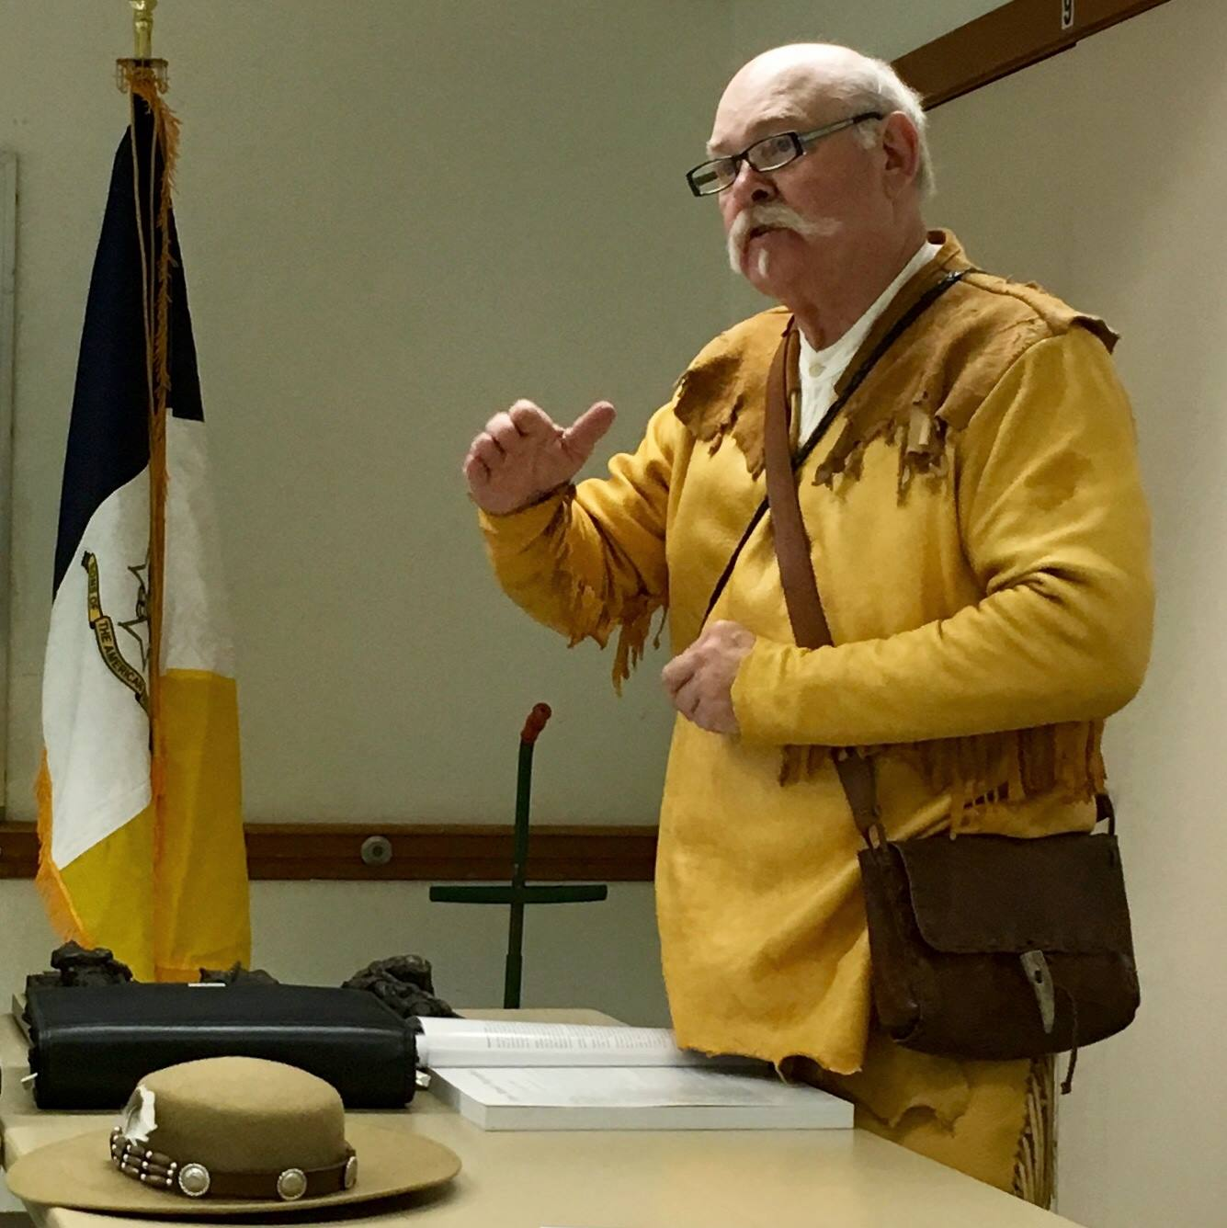
AMERICA 250 MINUTE
HISTORICAL PROGRAMS
Notes:
The Sons of the American Revolution offer America 250 Minutes, a program of brief Revolutionary messages that can be universally shared for the purpose of educating others with stories of Revolutionary events and people. These are ideal for you to present at your next Rotary or Kiwanis meeting because they are brief and thought provoking. Check America 250 Minutes for an opportunity to share the coming 250th Anniversary Celebration with your friends.

Slide 16
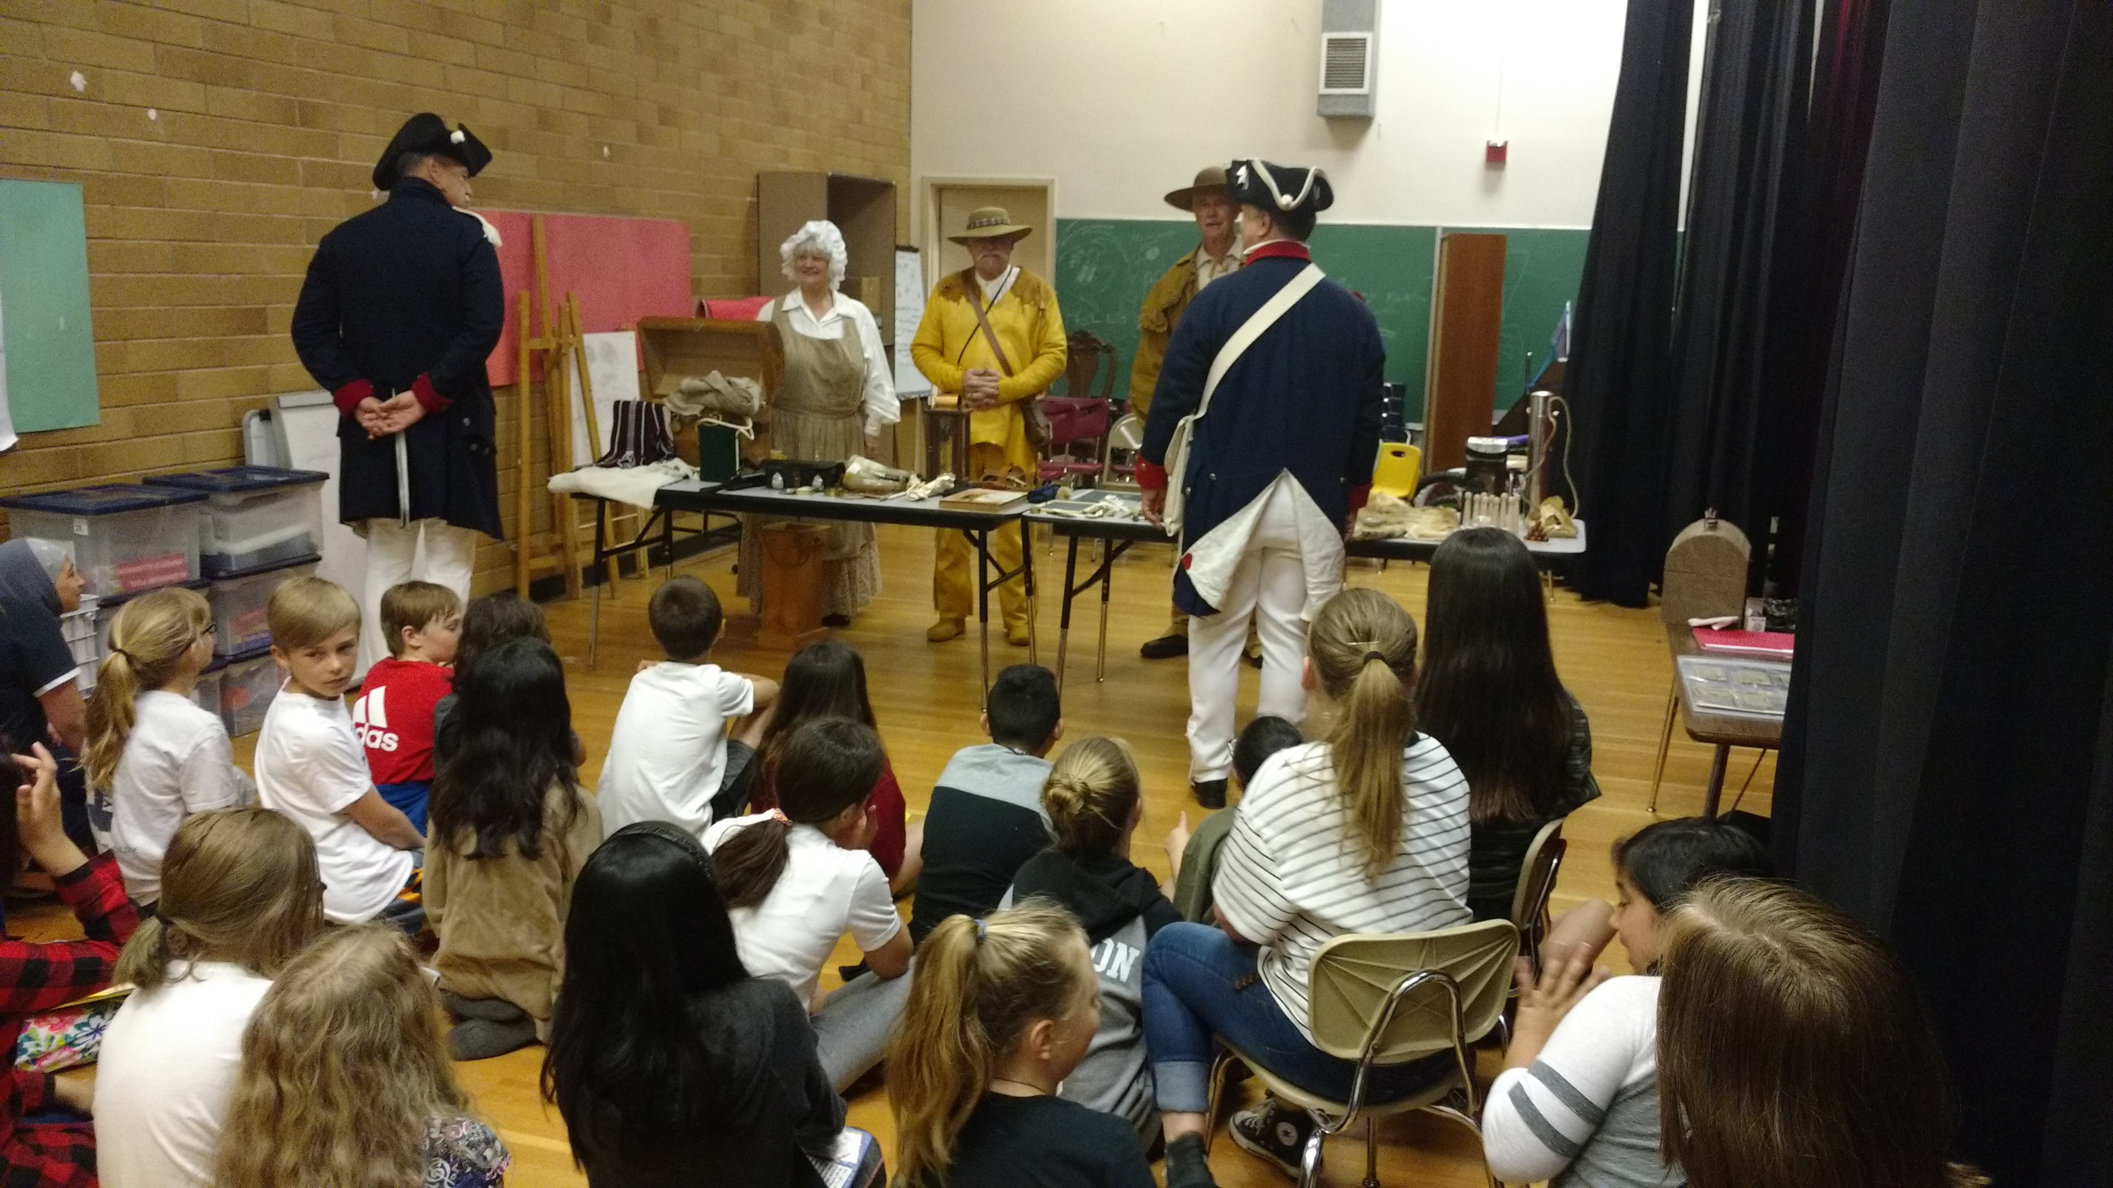
TRAVELING TRUNK
HISTORICAL PROGRAMS
Notes:
The Sons of the American Revolution Traveling Trunk Program is an excellent opportunity for historic education outreach. The Trunk is filled with replicas of American colonial era home, school, and military artifacts is a method of transporting a variety of teaching aids that can be used to tell the story of the Revolutionary era colonies. Reach out to SAR members that you know and invite them into your public or private school classroom or a session.

Slide 17
#3
Make the SAR a major source for online information on the American Revolution. Examples to date include:
    Genealogy Workshops with DAR
    Legends
    History Explorers
    Liberty Tree Environmental
    SAR Outreach Education
SAR GOALS
EDUCATIONAL PROGRAMS
Notes:
The third goal of the Sons of the American Revolution are a variety of Educational programs which may include sharing the history of local historic figures, characters of significance to the American Revolution, events of historic significance or genealogical training. This area is wide open because it covers so much of what the SAR does on a day-to-day basis in the community.

Slide 18
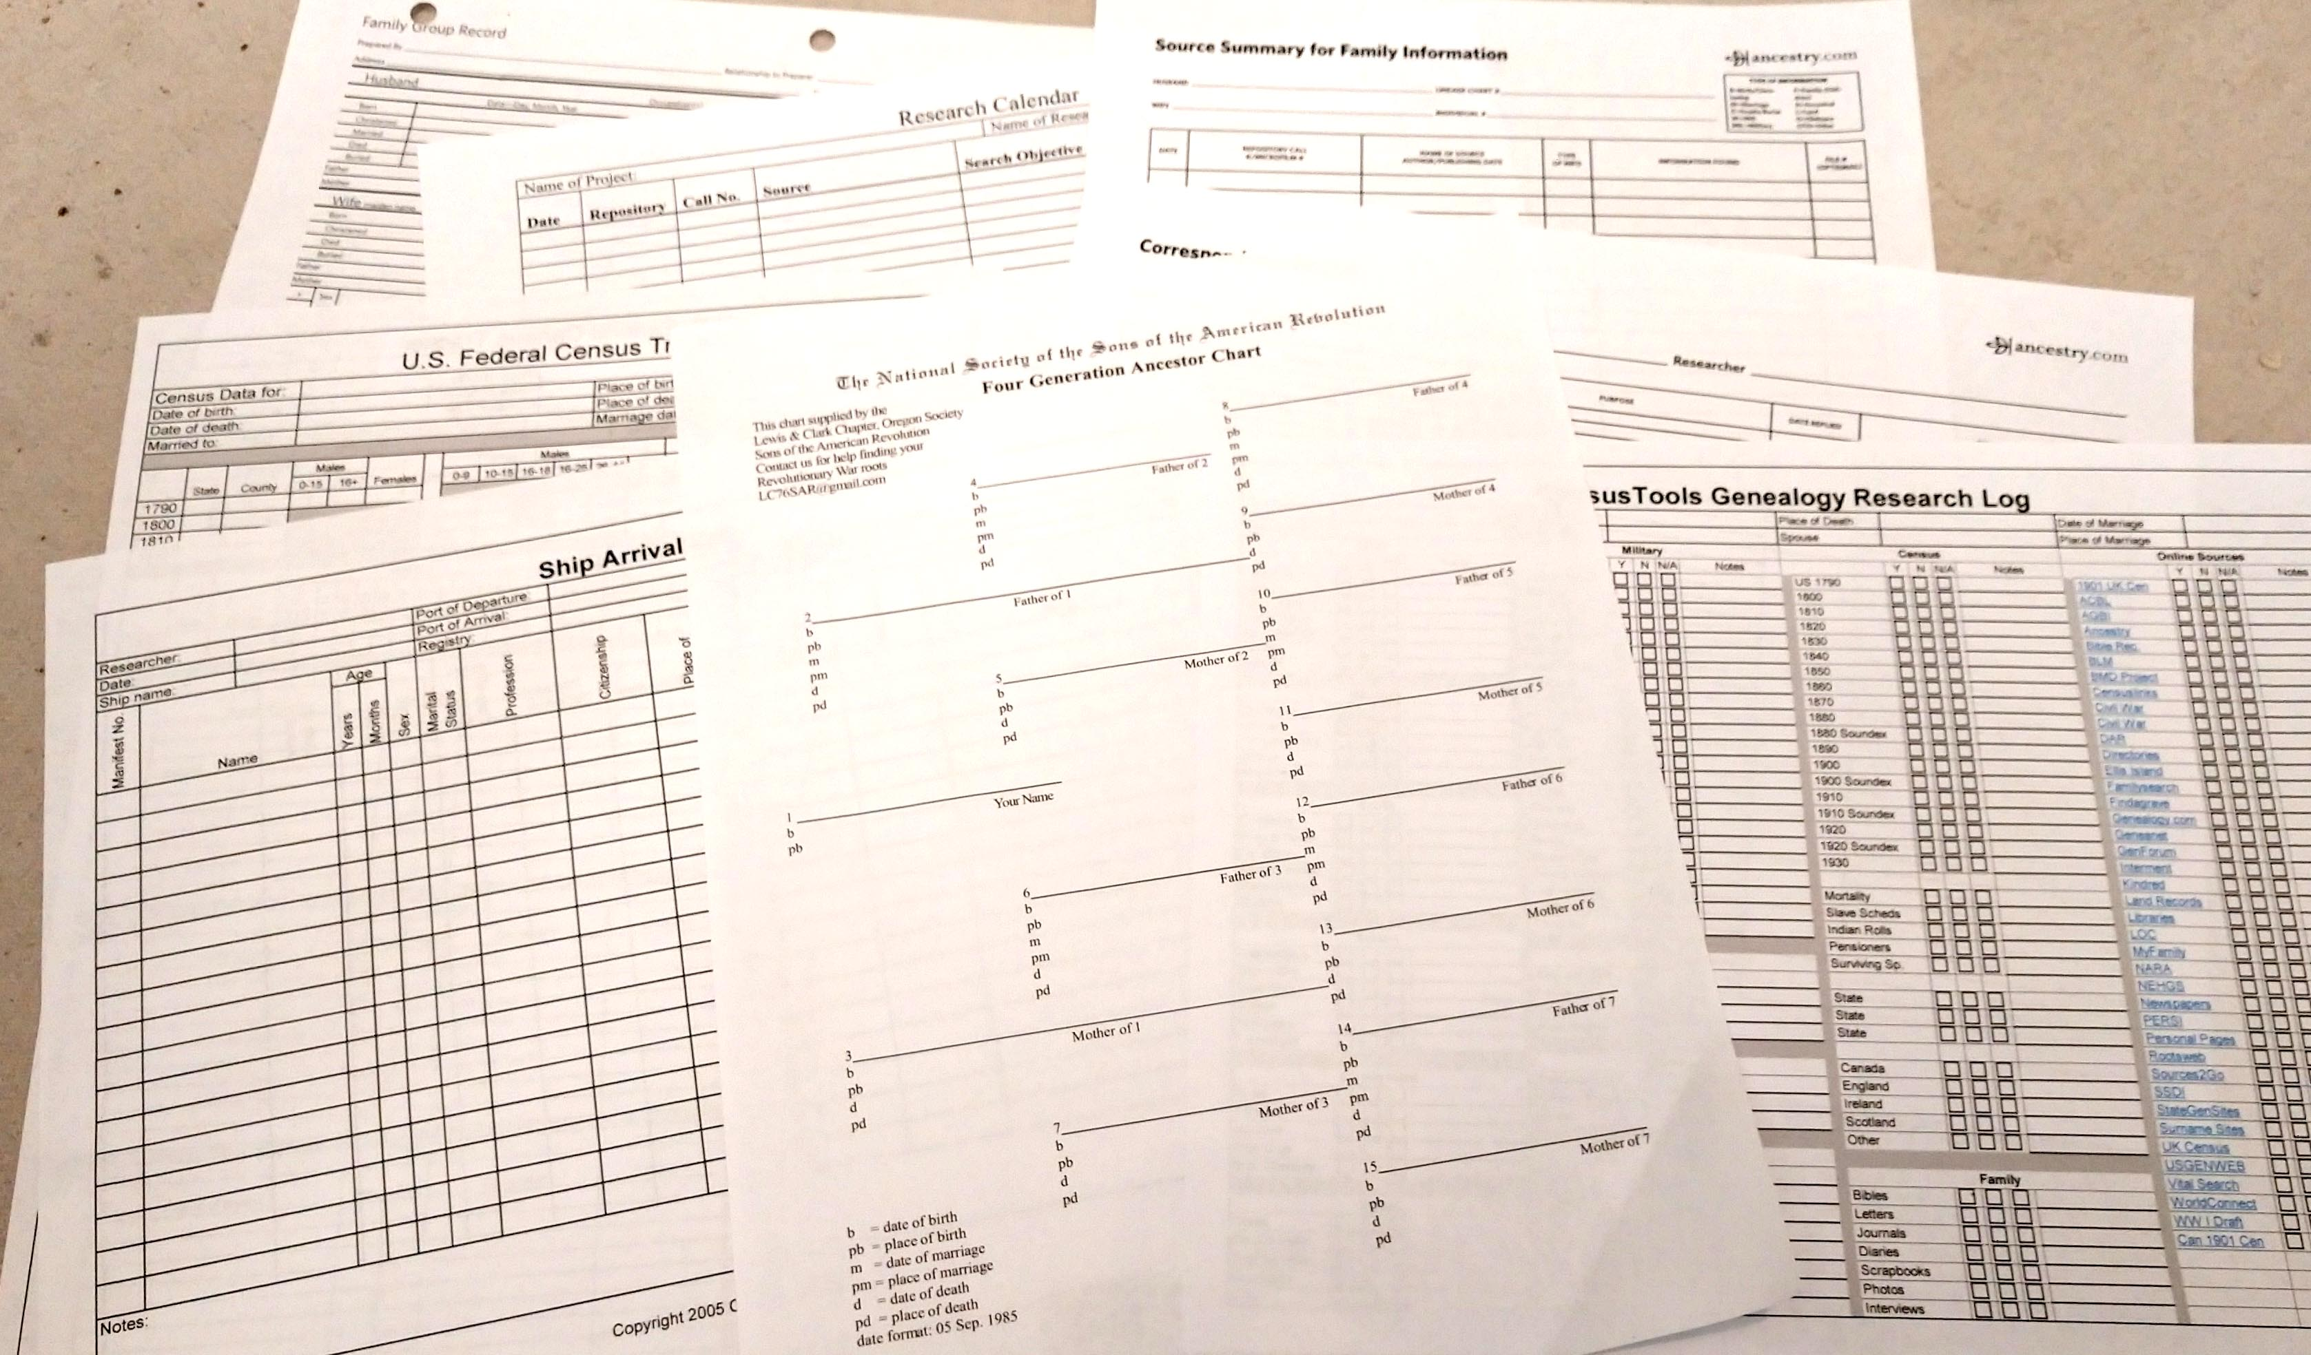
GENEALOGY WORKSHOPS
EDUCATIONAL PROGRAMS
Notes:
Many SAR chapters hold Genealogy Workshops with DAR, local genealogy society, archives, etc. By creating working groups, we can share the message of the 250th Anniversary through further research of our Patriot Ancestors and their descendants who may have settled in the area. Teaching genealogy to students is a truly eye-opening experience as they learn of the lives and accomplishments of their ancestors, students come alive with interest for their Founding Fathers. When a student finds proof of a Revolutionary connection you see that they too are part of this great nation, because they have a tangible link to that Patriot Ancestor.

Slide 19

HISTORY EXPLORERS
EDUCATIONAL PROGRAMS
Notes:
The America 250 SAR Committee, History Explorers, is a program of “patriotic education” with a focus on unique teachable moments, delivered through unique methods.
We begin each meeting with “Revolutionary Times;” discussing a significant event related to the American Revolution which took place in the month during the revolutionary period that we are making a presentation.
Use of the “Timeline to Revolution” 250th Anniversary events that are now occurring are the basis for these programs. Use of costumed presenters is encouraged, because it puts your Color Guard members in a public setting which focuses on our Revolutionary Patriots and offers positive branding for your SAR Chapter. It also makes your presentation more interesting when attendees can relate to your uniformed presenters and greeters in a different way.

Slide 20
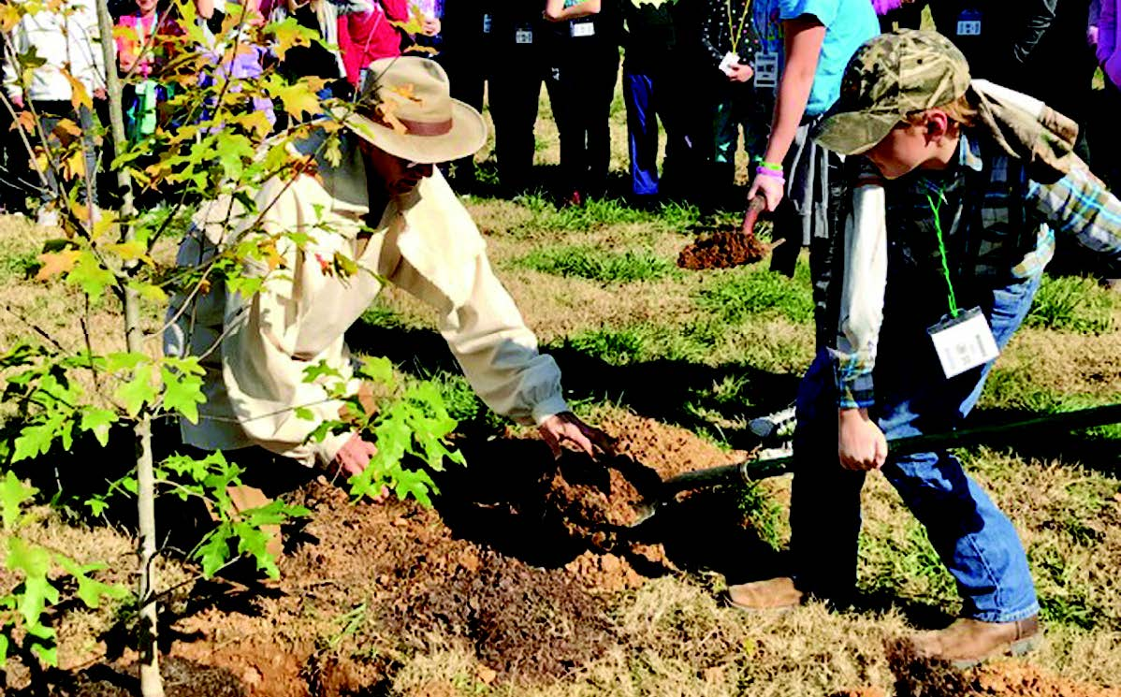
LIBERTY TREE
EDUCATIONAL PROGRAMS
Notes:
The concept of a Liberty Tree is as old as the Declaration of Independence itself. SAR Chapter members in historic dress discuss the many environmental benefits, economic value and cultural significance of America's trees and forests. Hands-on presentations demonstrate a wide variety of old and new wooden tools and products. The origin and role of Liberty Trees during the American Revolutionary War period are specifically highlighted.
Whenever possible, presentations are followed by a Liberty Tree planting ceremony. Only locally native tree species are planted. One of our SAR Chapters, the Cherokee Chapter, has a goal of planting 76 Liberty Trees by America’s 250th Anniversary celebration in 2026. Perhaps your school could plant a Liberty Tree and call on the local SAR Color Guard to help you mark the occasion.

Slide 21
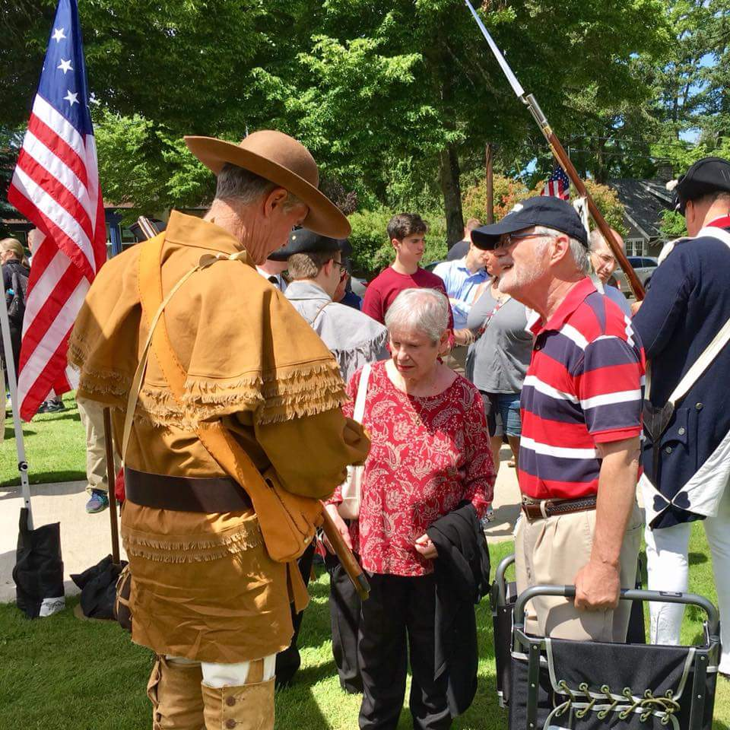
OUTREACH EDUCATION
EDUCATIONAL PROGRAMS
Notes:
The SAR Outreach Education program is open to and inclusive of public visitors and educators at any involvement level (SAR and non-SAR members alike) who would like to use this material for their educational purposes. The National Society of the Sons of the American Revolution welcomes all school groups, community groups and interested public members to visit the SAR National Headquarters located along Museum Row in downtown Louisville, Kentucky.
Further details concerning the available programs can be found in its School Programs Brochure, which can be printed and posted in classrooms and schools to encourage educator interest in the SAR. Educators may use the pre-visit guidelines for the Outreach Center Guidelines as a resource to prepare their students for their unique hands-on learning experience.

Slide 22
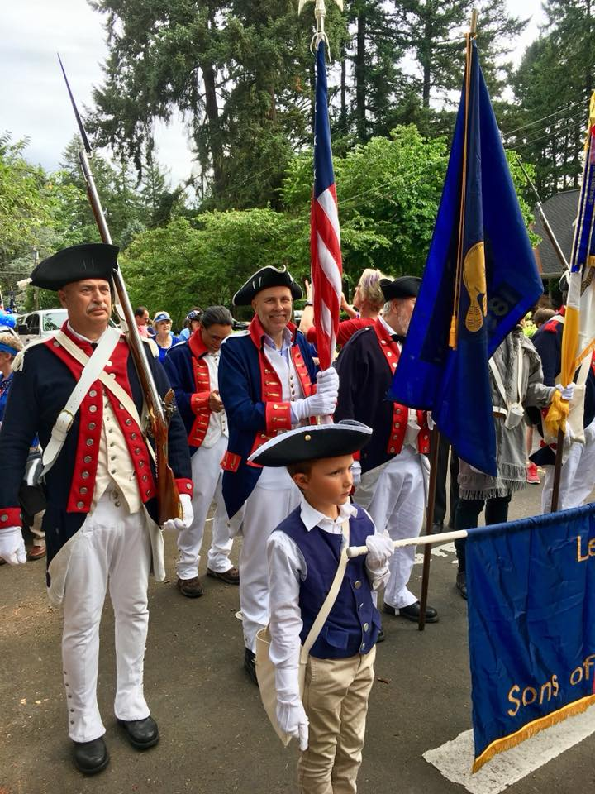
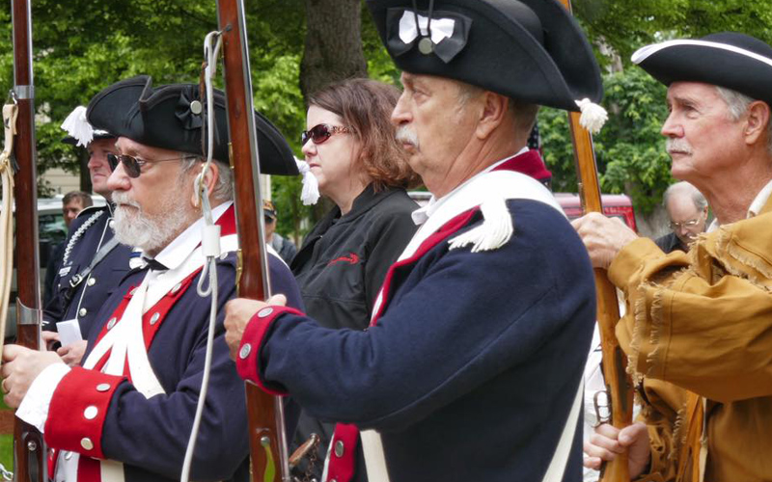
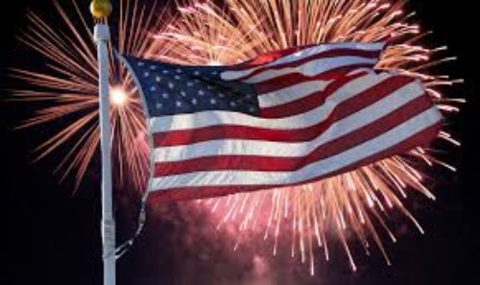
How You
Can Get Involved.
Notes:
Most of us remember the American Bicentennial Celebration and how much it meant to us as young people. Here, just 50 years later we can celebrate our 250th Anniversary and I ask you to find a way to get involved so that the young people in your community have the same opportunity that you did growing up.
Many parades and concerts and big special events will be planned but remember that you can make as much impact on your community through a small act that brings the story of the Revolution and our Founding Fathers to young people. This is your opportunity to be a hero of the American Revolution by sharing the celebration with others by retelling the stories of our Patriot Ancestors.

Slide 23
America 250 SAR Programs Committee
America250sar.org

